Slide 1
AUTOMATED CODE REVIEW
By: Shivam Mahadik
Roll no: 21102B0003
Div: B - CMPN
Subject: Software Engineering

Slide 2

WHAT IS AUTOMATED CODE REVIEW?
Automated code review is the process of using software tools to analyze and evaluate source code for potential issues, adherence to coding standards, and best practices. It helps identify bugs, security vulnerabilities, and performance bottlenecks early in the development lifecycle. By automating code review, developers can save time, improve code quality, and enhance collaboration.

Slide 3

BENEFITS OF AUTOMATED CODE REVIEW
Automated code review offers several
beneﬁts:
Improved code quality: Catching errors and enforcing coding standards
Increased productivity: Saving time on manual code reviews
Enhanced collaboration: Facilitating feedback and knowledge sharing
Early bug detection: Identifying issues
before they become critical
Consistent codebase: Enforcing coding guidelines across the team

Slide 4

BEST PRACTICES FOR AUTOMATED CODE REVIEW
Deﬁne coding standards: Establish clear guidelines for code quality
Customize rules: Tailor automated review rules to ﬁt your project
Integrate with CI/CD: Include code review in your continuous integration and deployment pipeline
Prioritize issues: Focus on critical and high-impact problems ﬁrst
Encourage developer feedback: Foster a culture of learning and improvement

Slide 5
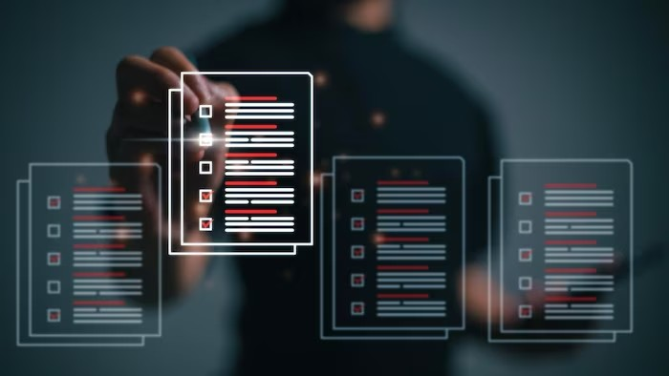
Choosing an Automated Code Review Tool
SonarQube
Language support: Ensure the tool supports your programming language(s) Customizability: Ability to conﬁgure rules and thresholds
Integration: Seamless integration with your development environment Reporting and analytics: Comprehensive reports and actionable insights
Community support: Active community and regular updates
PHP CodeSniffer
JSHint
Pylint

Slide 6

AUTOMATED CODE REVIEW IN ACTION
Developers push code to the repository
The automated code review tool scans the codebase
It identiﬁes potential issues and generates a report
Developers review the report and address the identiﬁed problems
The code is rechecked, and the process continues iteratively
This iterative feedback loop helps maintain code quality throughout the development lifecycle.

Slide 7
CONCLUSION
Automated code review is like having a superpower for improving software. To unleash its full potential:
Pick the Right Tool
Set Clear Coding Standards
Make Code Review a Part of development Process

Slide 8
Thank You!

